Slide 1
President
ROLES (Article II in the Constitution)

Slide 2
Chief Executive
What?
Carry out or execute laws passed by Congress
Appoints several thousand officials (cabinet, federal judges)
Supervises administration of executive department
How?
15 Cabinet Departments → Heads of departments are appointed by the President
Federal Agencies: 3 million civilians work for the federal government
Roles:
The "boss" for millions of government workers in the Executive Branch
Decides how the laws of the United States are to be enforced
Chooses officials and advisers to help run the Executive Branch
Examples of Behavior in Roles:
Appointing someone to serve as head of the Central Intelligence Agency (CIA)
Holding a Cabinet meeting to discuss government business Video

Slide 3
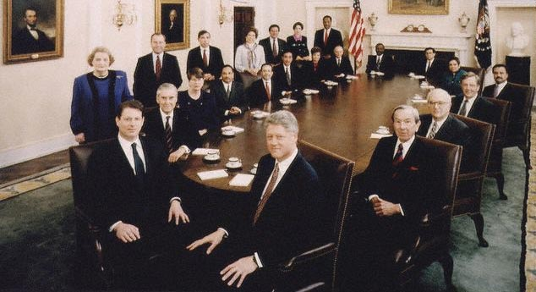
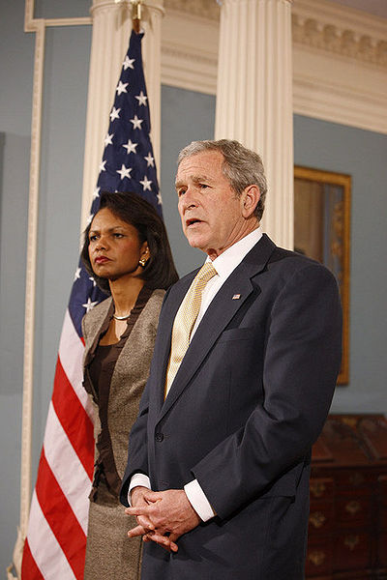
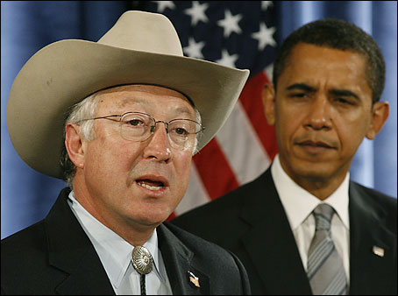
Cabinet Appointments
President Clinton's Cabinet, 1993. The President is seated front right, with Vice President Al Gore seated front left.
President Bush chose Condoleezza Rice as Secretary of State in his second term
Obama announces Colorado governor Ken Salazar as Secretary of the Interior

Slide 4
Chief Executive Tools
Executive Order: a rule or command that has the force of law or “Presidential rules that have the force of law” (must be Constitutional and agree with current law)
?? But the President doesn’t make laws . . . right? That is true, but he does have the constitutional power to help enforce the laws created in Congress
“take care that the laws are faithfully executed”
Examples of an Executive Order:
Listing of Executive Orders by year:

Slide 5
Chief Executive Tools
Pardon: a declaration of forgiveness and freedom from punishment; with the exception of impeachment
Examples –
7 famous pardons
Statistics
Amnesty: a pardon toward a group of people
Examples–
Every Confederate Soldier: On Christmas Day 1868, President Andrew Johnson declared a general amnesty that unconditionally pardoned everyone who'd fought for the Confederacy during the Civil War.
10,000 Men who avoided the Vietnam military draft –: In 1977, President Jimmy Carter provided a pardon to any Vietnam draft dodgers who requested one.
Reprieve: an order to delay a person’s punishment until a higher court can hear the case

Slide 6
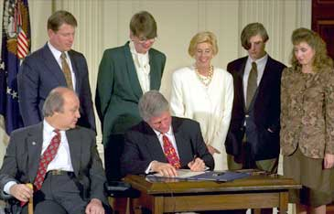
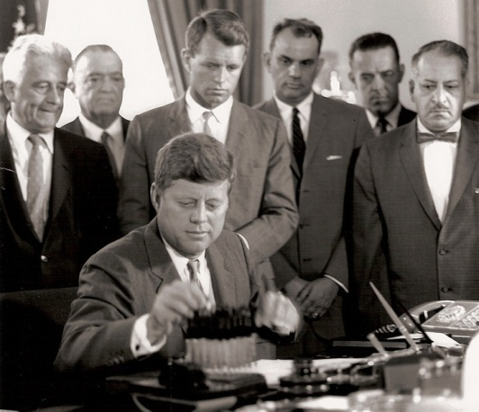
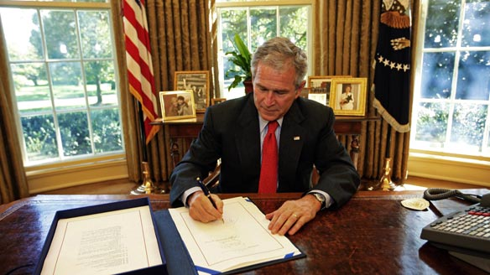
Chief Legislator
What? President proposes a legislative program to Congress
How? Make speeches, assign staff members to work with members of Congress to influence legislation, State of the Union Address
Roles: Only Congress has the actual power to make laws. But the Constitution gives the president power to influence Congress in its lawmaking. Presidents may urge Congress to pass new laws or veto bills that they do not favor.
Examples of Behavior in Roles:
Inviting members of Congress to lunch in the White House.
Gives Congress information on the state of the union
Signing a bill of Congress. Veto a bill.
Making a speech in Congress.
Conflict: President VS. Congress → President represents whole nation, Congress represents their state or district → President wants action on laws now because of his short term, Congress often doesn’t feel time constraint because many are elected over long periods of time

Slide 8
Chief Legislator Legislative Tools
pocket veto - the president's inaction on legislation while Congress is adjourned, cannot be overridden
"The Constitution grants the president 10 days to review a measure passed by the Congress. If the president has not signed the bill after 10 days, it becomes law without his signature. However, if Congress adjourns during the 10-day period, the bill does not become law."
veto - bill is rejected
The procedure established under the Constitution by which the President refuses to approve a bill or joint resolution and thus prevents its enactment into law. A regular veto occurs when the President returns the legislation to the house in which it originated. The President usually returns a vetoed bill with a message indicating his reasons for rejecting the measure. The veto can be overridden only by a two-thirds vote in both the Senate and the House.

Slide 9
Chief Legislator Legislative Tools
override of a veto - The process by which each chamber of Congress votes on a bill vetoed by the President. To pass a bill over the President's objections requires a two-thirds vote in each Chamber. Historically, Congress has overridden fewer than ten percent of all presidential vetoes.
presidential signature - A proposed law passed by Congress must be presented to the President, who then has 10 days to approve or disapprove it. The President signs bill, making it a law.
Track President’s Legislation → (VETO, POCKET VETO, SIGN) Video: All The President’s Pens

Slide 10
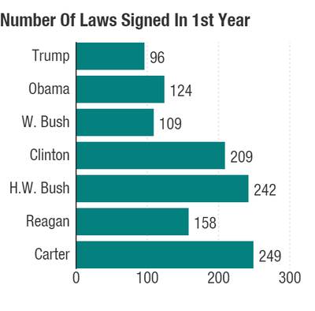
NPR

Slide 11
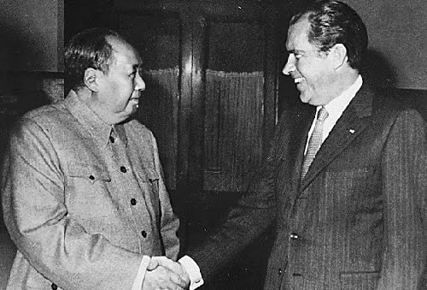
Chief Diplomat
What? Directs foreign policy https://www.whitehouse.gov/america-first-foreign-policy
How?
Represents U.S. in foreign relations
Makes treaties with the approval of 2/3 of Senate
Appoints ambassadors, ministers, and consuls
Roles: The president decides what American diplomats and ambassadors shall say to foreign governments. With the help of advisers, the president makes the foreign policy of the United States.
Examples of Behavior in Roles:
Traveling to London to meet with British leaders.
Entertaining Japanese diplomats in the White House.
Chairman Mao and Nixon

Slide 12
Commander in Chief
What? Chief of the Armed forces ( Army, Navy, Air Force, Marines, Coast Guard (US armed forces)
How?
Determines major strategies during war
Uses military power in domestic disorder to reinforce laws
Orders troops into battle (Congress declares war)
Only 5 Wars declared → War of 1812, Mexican War, Spanish-American War, WWI, WWII
Since 1789, Presidents sent troops into battle more than 150 X
War Powers Act: (1973) President must notify Congress within 48 hours when troops are sent into battle. If Congress doesn’t give its approval for the troops to remain longer or declare war, troops must be brought home after 60 days
Roles: The president is in charge of the U.S. armed forces: the Army, Navy, Air Force, and Marines. The president decides where troops shall be stationed, where ships shall be sent, and how weapons shall be used. All military generals and admirals take their orders from the President.

Slide 13
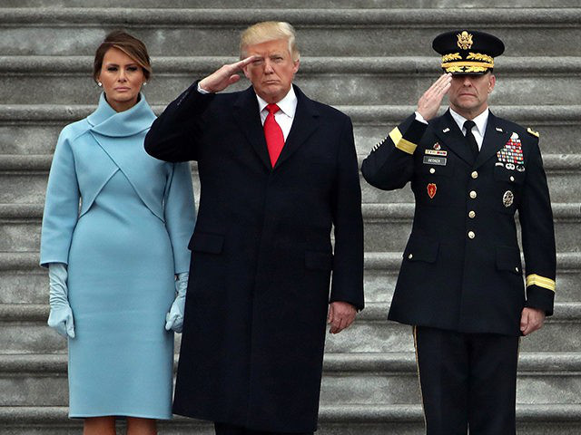
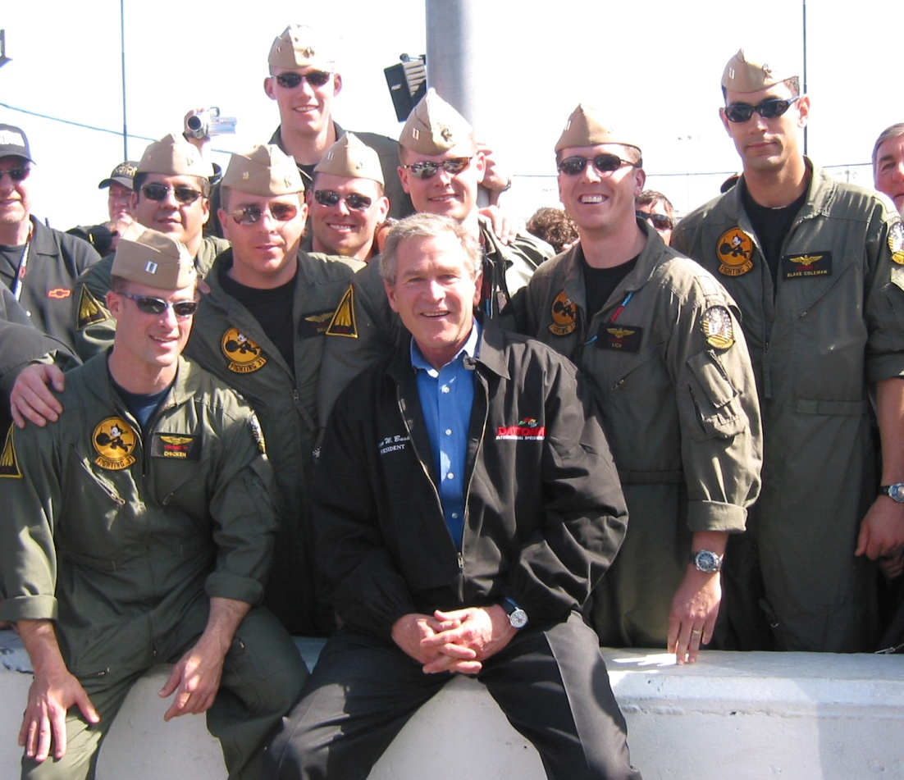
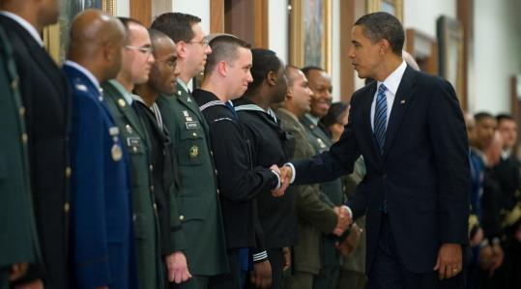
Commander in Chief
Daytona, Fla. (Feb. 14, 2004) – Aircrew assigned to the Naval Air Station Oceana-based “Tomcatters” of Fighter Squadron Three One (VF-31) take an opportunity to meet with the Commander in Chief
President Obama congratulating military officers at banquet as Commander-in-Chief

Slide 14
Commander in Chief
Examples of Behavior in Roles:
Inspecting a Navy yard.
Deciding, in wartime, whether to bomb foreign cities.
Calling out troops to stop a riot.
Joint Chiefs of Staff:
(click on “JCS Leadership”, “Joint Chiefs”, then each of the leaders: Airforce, Army, Navy, Marine)
Medal of Honor Video
Defense: Obama on the defense of the US
Example – Obama’s foreign policy & Trump’s foreign policy
Video: Obama support service members and their families

Slide 15
Chief of State
What? Living symbol of US
How?
Formally greets visiting foreign leaders
Addresses the nation
Entertains in state dinners
Performs ceremonial duties

Slide 16
Chief of State
Roles: This role requires a president to be an inspiring example for the American people. In some nations, the chief of state is a king or a queen who wears a crown on special occasions, celebrates national holidays, and stands for the highest values and ideals of the country. As the American Chief of State, the president is a living symbol of the nation. It is considered a great honor for any citizen to shake the president's hand.
Examples of Behavior in Roles:
Awarding medals to the winners of college scholarships.
Congratulating astronauts on their journey into space.
Greeting visitors to the White House.
Ceremonial Functions: lighting of national Christmas tree, gives medals to heroes
Making a patriotic speech on the Fourth of July.
Holiday Ceremony:

Slide 17
Economic Leader
What?
plans federal government’s budget
Deals with unemployment, high taxes, rising prices
develop programs and plans that are intended to boost the economy
How? Develops programs and plans that are intended to boost the economy.
Roles: In this role, the president is concerned with such things as unemployment, high prices, taxes, business profits, and the general prosperity of the country. The president does not control the economy, but is expected to help it run smoothly.
Examples of Behavior in Roles:
Meeting with economic advisers to discuss ways to reduce unemployment.
Meeting with business and labor leaders to discuss their needs and problems.
Obama and the Economy:
American Jobs Act Bus Tour – Plan in WV -- Chart
Trump’s Budget - graphs

Slide 18
Chief of Party (Party Leader)
What? Leader of Political Party
Leads his political party by establishing a platform or important issues they represent
How?
give speeches to support party members running for office
help party raise money
Roles: In this role, the president helps members of his political party get elected or appointed to office. The president campaigns for those members who have supported his policies. At the end of a term the president may campaign for reelection.
Examples of Behavior in Roles:
Choosing leading party members to serve in the Cabinet.
Traveling to California to speak at a rally for a party nominee to the U.S. Senate.

Slide 19
Practice Roles of President The Many Hats of the President Read each scenario and determine which hat the President wore when he executed his power.
1. President Clinton oversaw the signing of a new accord in September, 1993 between Palestinian leader Yasser Arafat and Israeli Prime Minister Yitzhak Rabin. Clinton and his administration hosted this historic compromise at the White House. Which hat did Clinton wear while hosting?
2. President Grover Cleveland in his first term (1885-1889) received a controversial bill approved by the House of Representatives and the Senate, he chose to reject" the bill. In fact, Cleveland "rejected" more bills in this first term than all preceding presidents combined. Which hat was Cleveland sporting?
3. Once in office, Clinton quickly set about starting the reforms he had promised during his campaign. To achieve his vision of change, Clinton put together the most racially diverse and gender-balanced cabinet in U.S. history. Those hand picked by Clinton were Henry Cisneros as Secretary of Housing and Urban Development, Ron Brown Secretary of Commerce, Jocelyn Elders as Surgeon General, and Press Secretary Dee Dee Myers.
Which hat was Clinton wearing while making these official changes?

Slide 20
Practice Roles of President The Many Hats of the President Read each scenario and determine which hat the President wore when he executed his power.
4. North Korean people are starving. They are in desperate need of food and other supplies. They have asked the United States for help. They also have several weapons that could be used against us if they fell into the wrong hands. If Clinton decides to send food and aid in the interest of keeping North Korea on our side, which hat would he be wearing?
5. Richard Nixon was part of the Watergate Affair which involved such criminal acts as burglary, illegal wiretapping, perjury, conspiracy to obstruct justice, and misuse of campaign funds. Gerald Ford, Nixon's successor, "excused" him which allowed him to be immune from prosecution. Which hat did Ford have on?
6. George Bush's experiences during WWII contributed to his strong interest in foreign affairs. During his presidency, terrible memories about WWII resurfaced when he felt it necessary to send troops to Kuwait during Operation Desert Storm. When he executed this plan to aid Kuwait and bombard Saddam Hussein, which hat was he wearing?

Slide 21
Practice Roles of President
Egypt and Israel continue to fight and bring even more instability to the Middle East. You are very concerned about this situation and would like to rejuvenate the peace process in the Middle East. What power do you have in this situation and what role grants you this power?
You are a Republican president and a fellow Republican is running for Governor of West Virginia. You would really like to help her win the office. What can you do to assist &what gives you the power?

Slide 22
Practice Roles of President
A bill has been sent to you by Congress that involves making flag burning illegal. You disagree with this bill and absolutely do not want such a law passed. What can you do to act to reflect your opposition, and what role enables you to do it?
You have been given reconnaissance imagery revealing Soviet nuclear missile installation in Cuba. You feel these nuclear weapon pose and incredible danger. What can you do, and what gives you the power?

Slide 23
Practice Roles of President
It is about that time when you need to address Congress and outline your agenda for the year. You also need this information broadcast to the people. What annual tradition will follow to deliver this information, and what role gives you this power?
It is December, and Washington DC is buzzing with holiday spirit. You want to make sure the White House sticks with tradition and embraces this season. What should you make sure to mark on your calendar this December?
You are passionate about a new health care program that you have developed, which contains several laws that you want Congress to pass. Since only members of Congress have the power to introduce bills for consideration, what can you do to advocate for your health care legislation? What role gives you the ability to do this?

